Slide 1
Global Water – Las Quintas Serenas Water Company, Inc. Update
Jon Corwin, Vice President and General Manager
Beth Huerta, Client Services Manager January 12, 2023

Slide 2
Agenda
Global Water
System Improvements
Customer Portal
Rate Case Update
Customer Assistance Program Review

Slide 3
About Global Water
Founded in 2003
Only Operate in Arizona
Employ Approximately 100 Arizonans – Engineers, Certified Operators, Compliance and Safety Professionals
Provide Water, Wastewater and Recycled Water Service to Over 56,000 Connections
Conservation Focus
Total Water Management
Saved over 10 billion gallons of water since 2004
Customer tools for conservation

Slide 4
Global Water – Las Quintas Serenas Water Company, Inc.

Slide 5
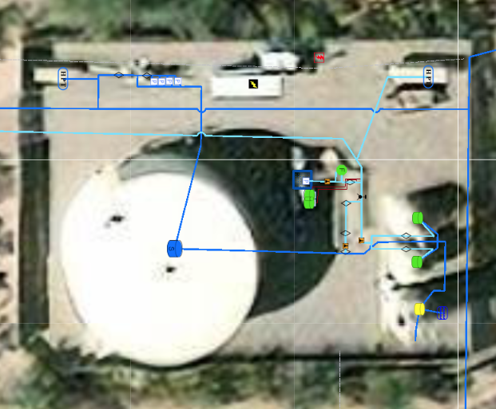
Integration Work Completed
Staffed Call Center and After-Hours Service (Nov 2021)
Asset Management / GIS Deployment (On-Going)
Improved asset maintenance tracking
Digitized as-built drawings
Enhanced emergency response
Enhanced IT & OT Security (Jun 2022)
Utility Focused – Water Resources, Compliance, Safety, Maintenance Expertise
Technology Integration (Dec 2021)
Increased Workflow Efficiency
Record Retention

Slide 6
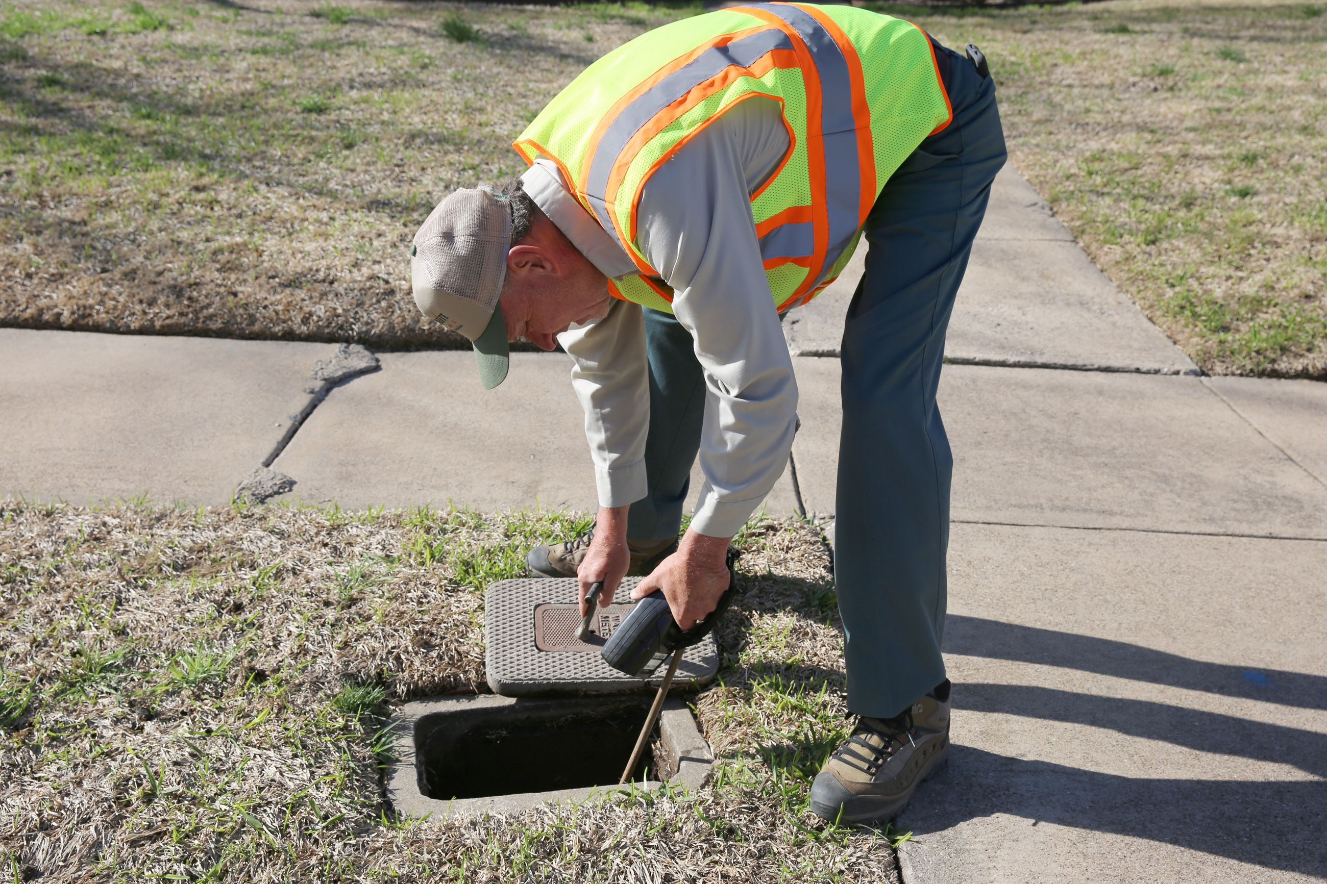
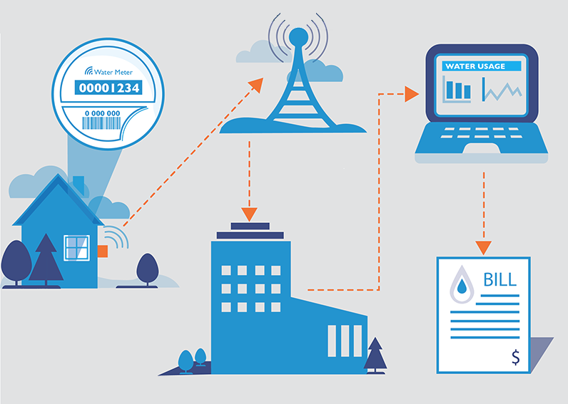
LQS Meter Exchange Summary
Replaced 1,095 meters Installed Neptune R900i E-CODER Meters
Obtain reads at 15-minute intervals and data presented to customers in hourly intervals
96 days of stored history
Meter reading process takes approximately 3 manhours vs. 40 manhours
Opportunity for human error significantly reduced
Manual Reads
To
Automated Reads

Slide 7
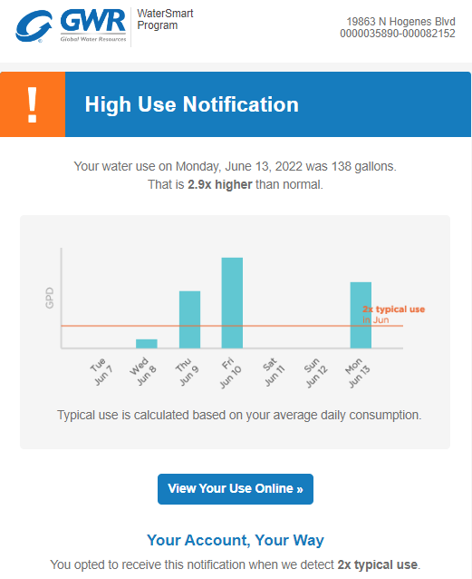
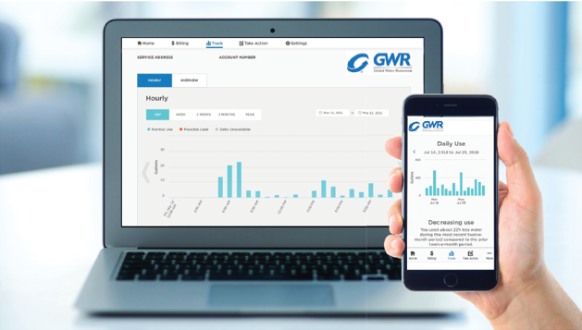
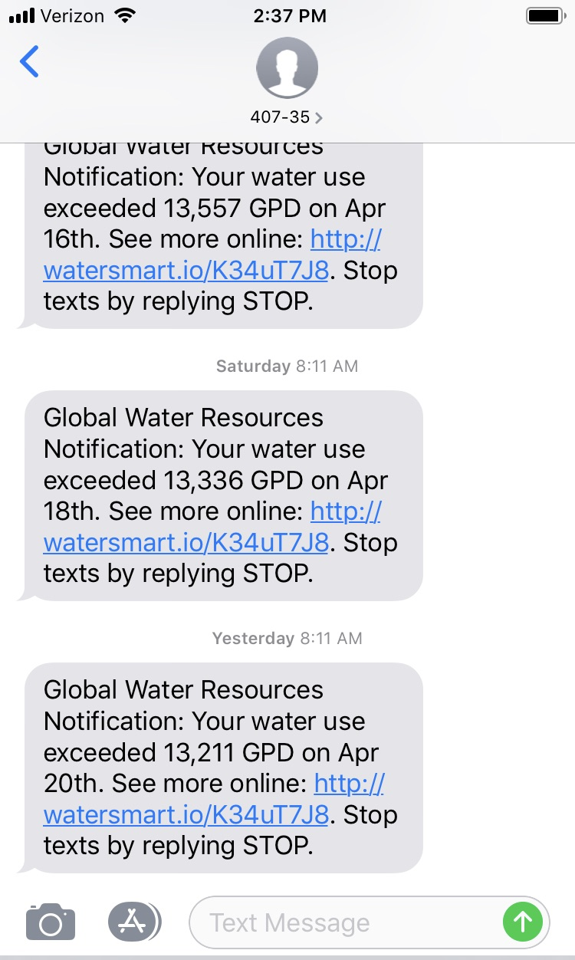
Customer Portal

Slide 8
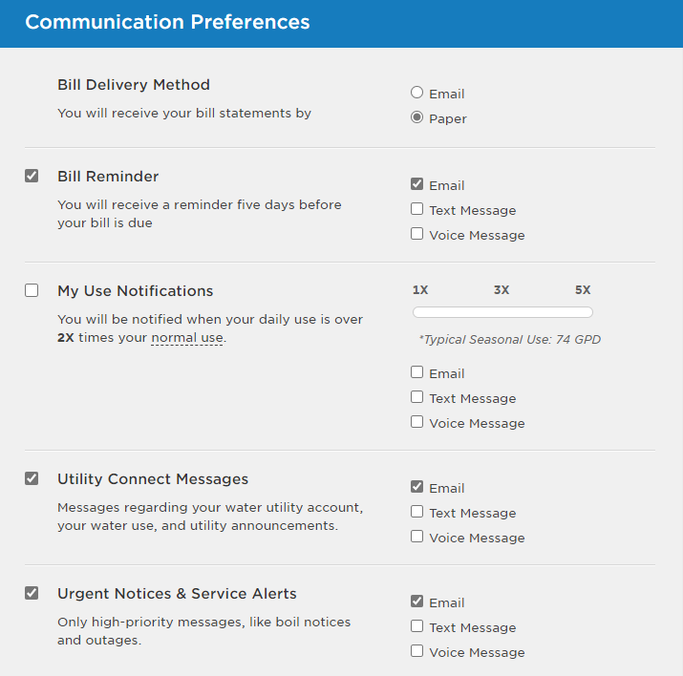
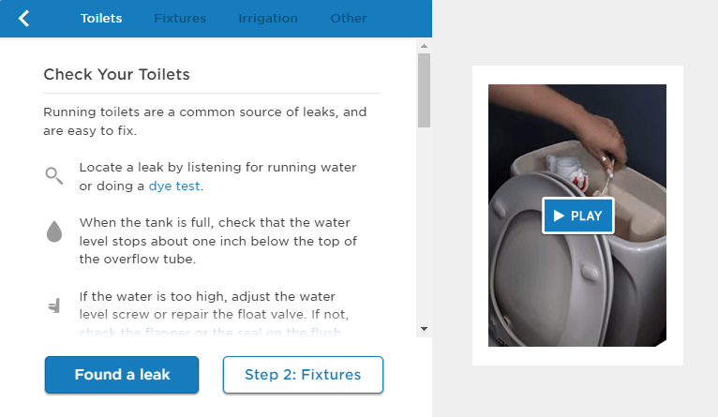
Customer Portal
Track Monthly Consumption
Set-up Usage Alerts & Billing Preferences
Easy Payment Methods
Tools to Troubleshoot High Consumption

Slide 9
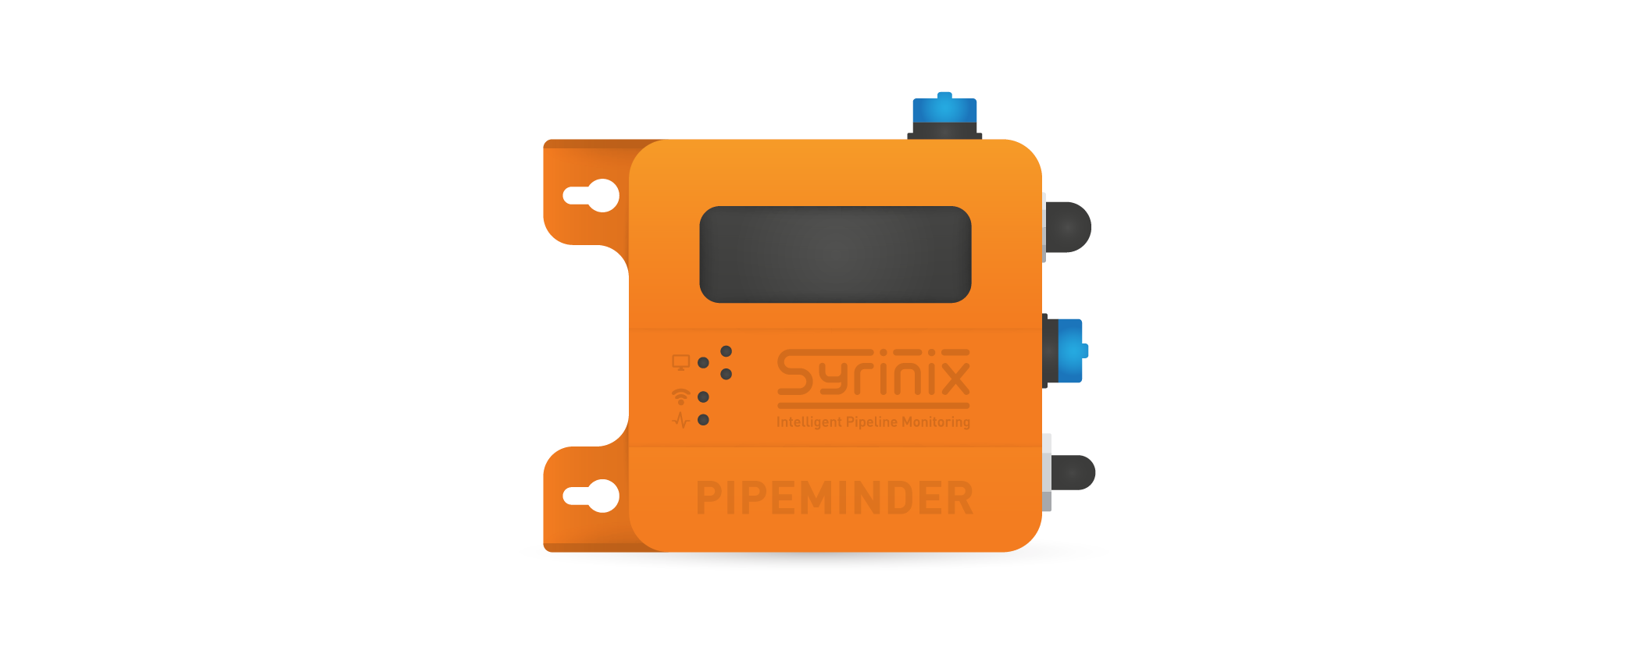
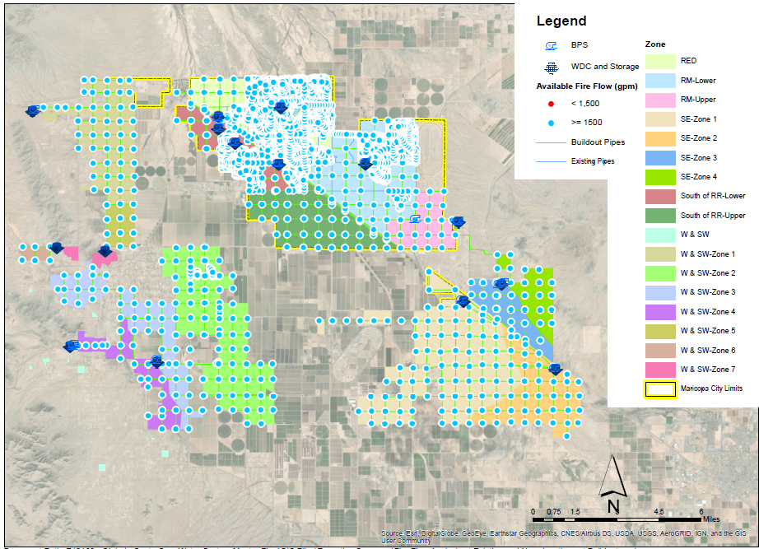
Pressure Issues
Installed Syrinix Pipeminder Loggers at Well 5 & Standpipe
Initial results indicate decreased pressure related to standpipe usage
Next Steps:
2023 - Engineer Advanced Water Model
Validation of system dynamics
Detailed assessment of system capacities
Identify potential system enhancements
Update Town Staff on Water Model Findings

Slide 10
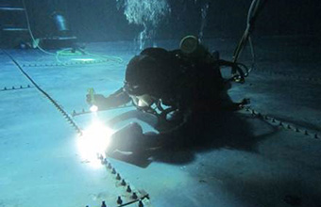
2023 Planned Improvements
Standpipe Upgrades
Chlorine Injection at Well 5
Improved water quality and safety
Valve Maintenance and Replacement
Tank Inspections
Long Range CAPEX Planning
Enhanced SCADA Controls and Automation
Tank Repairs and Rehabilitation
Infrastructure Rehabilitation (Wells, Pumps, Motors)

Slide 11
Rate Case
Probable for Rate Case Filing in Mid-2023
In-depth review by Arizona Corporation Commission
Reason for a Rate Case
Last rate case was in 2012
Inflation - labor, materials, chemicals, fuel, power have all increased significantly
Recover costs of system improvements
Process/Timing
Rate case timeclock is 270 days meaning, once we file, rates will not be implemented for 270 days. No rate change until late 2023 or early 2024
Commit to Come Back and Provide Updates

Slide 12
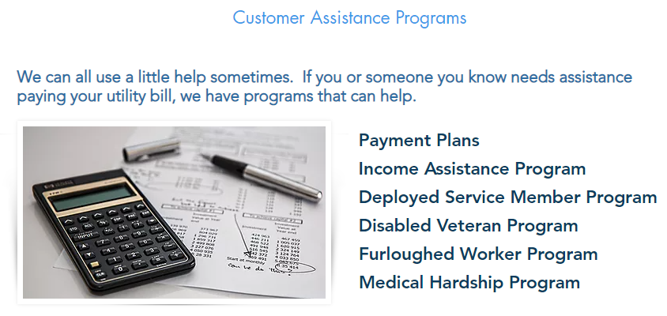
Customer Assistance Program
Summer 2022 – Implemented Customer Assistance Program
Up to $350 in annual assistance
Eligibility
Low Income
Deployed Service Members
Disabled Veterans
Furloughed Workers
Medical Hardship
GWR contribute $50,000 Annually

Slide 13
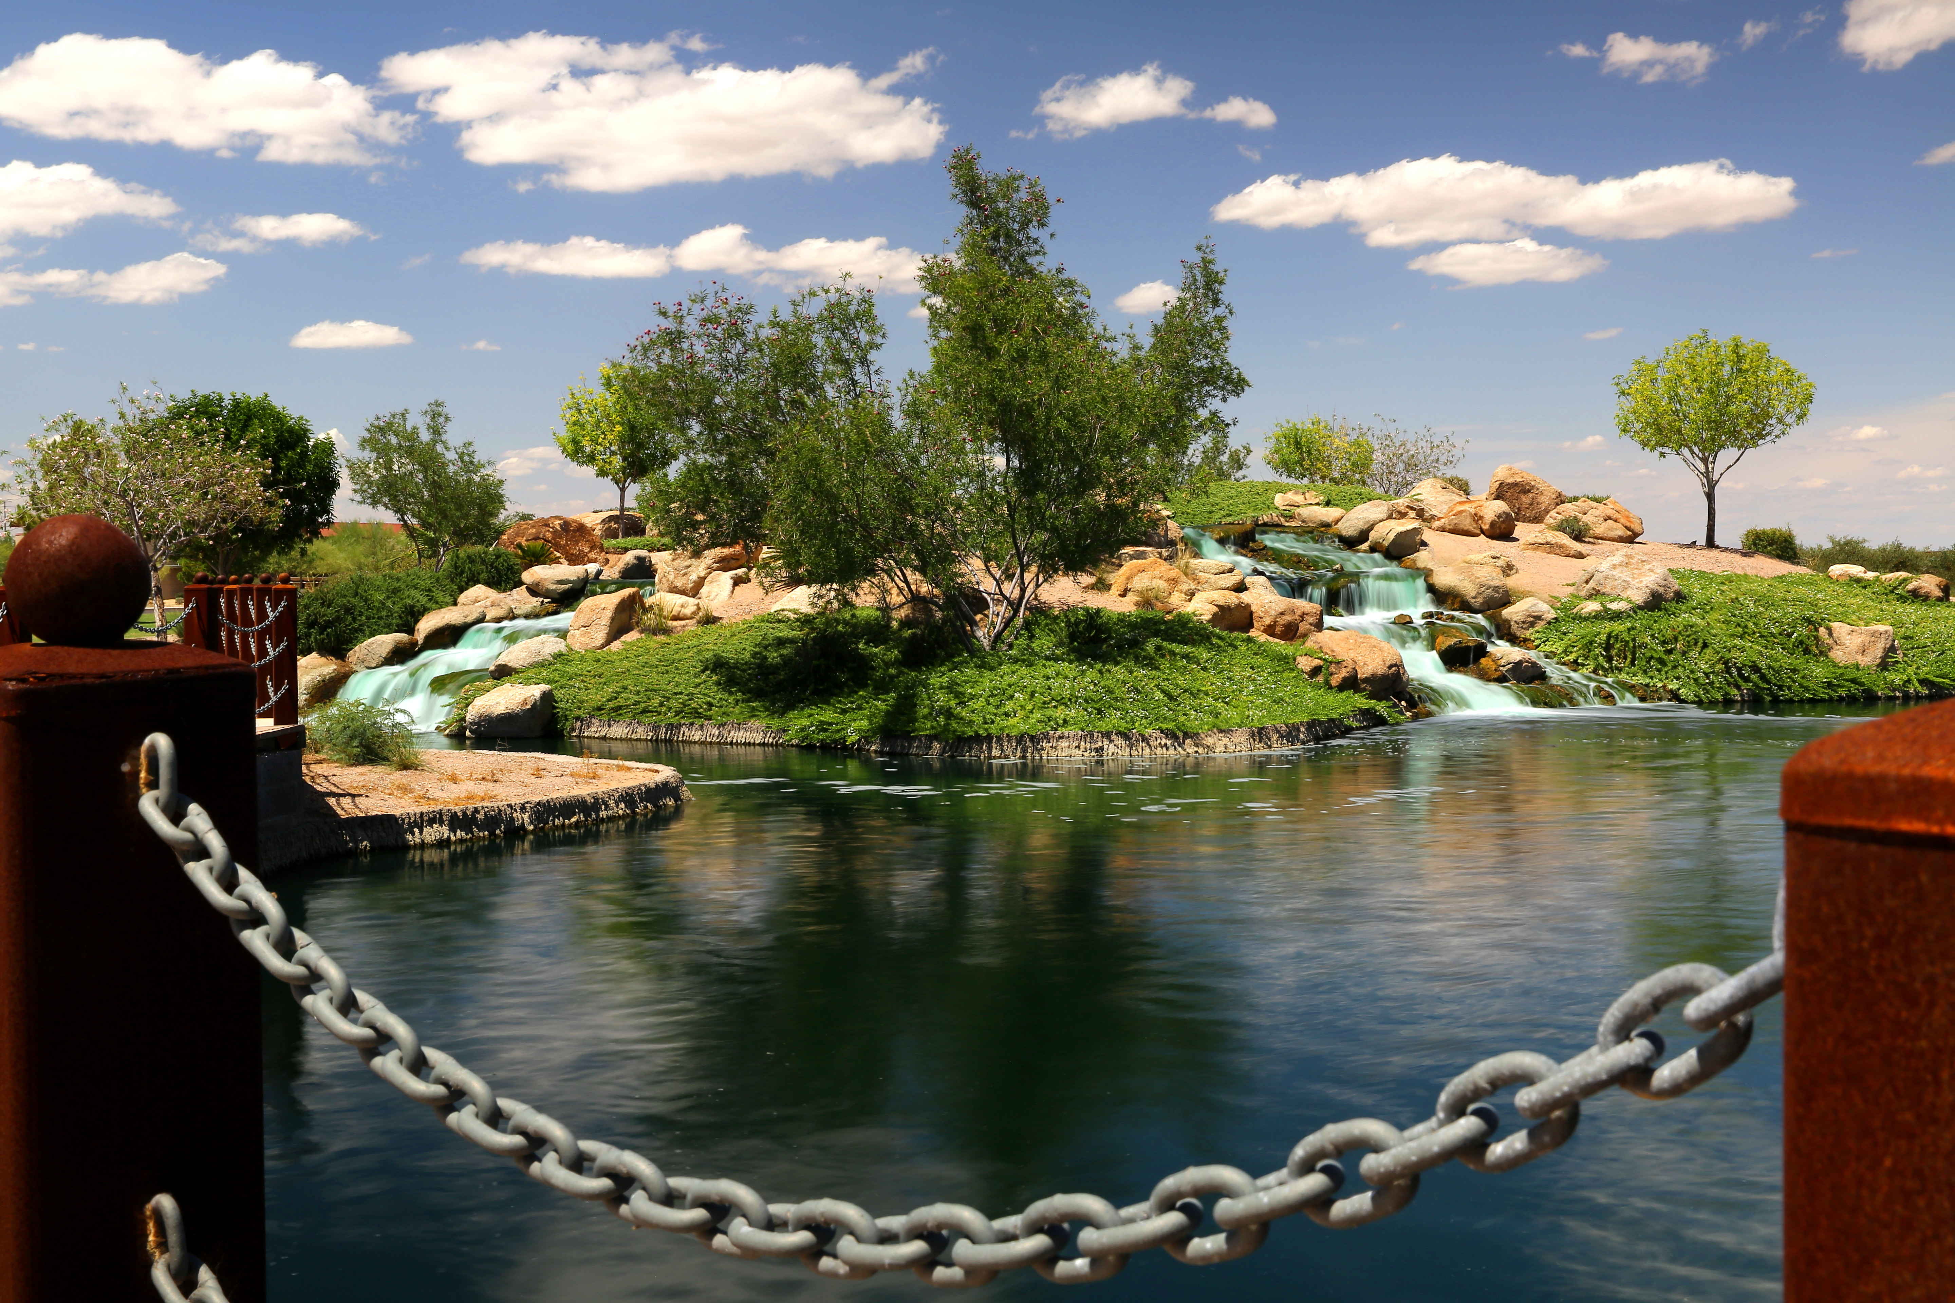
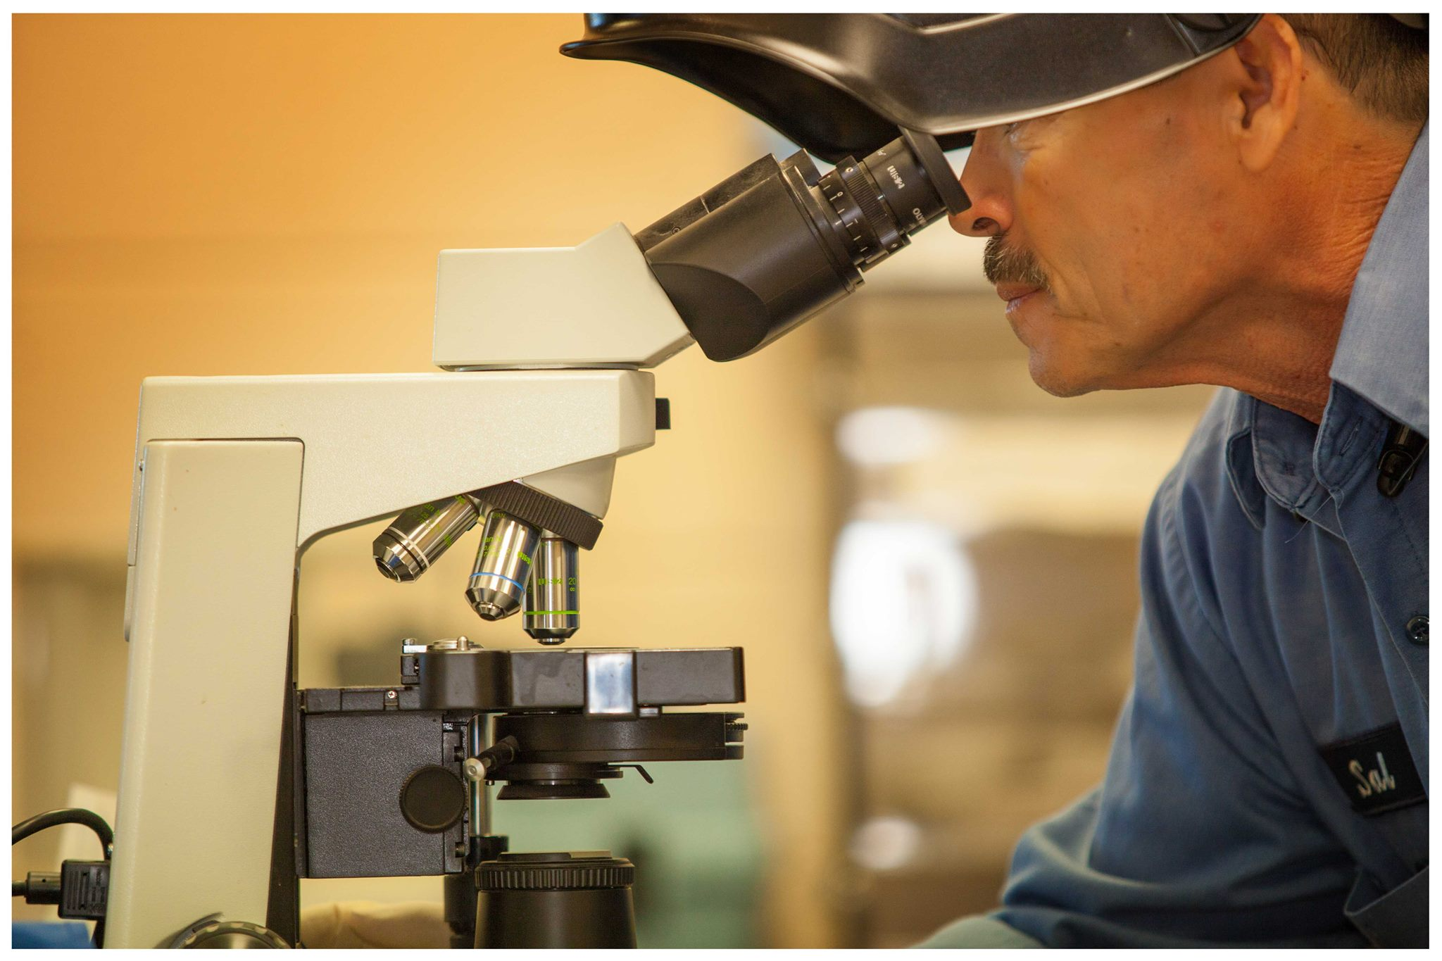
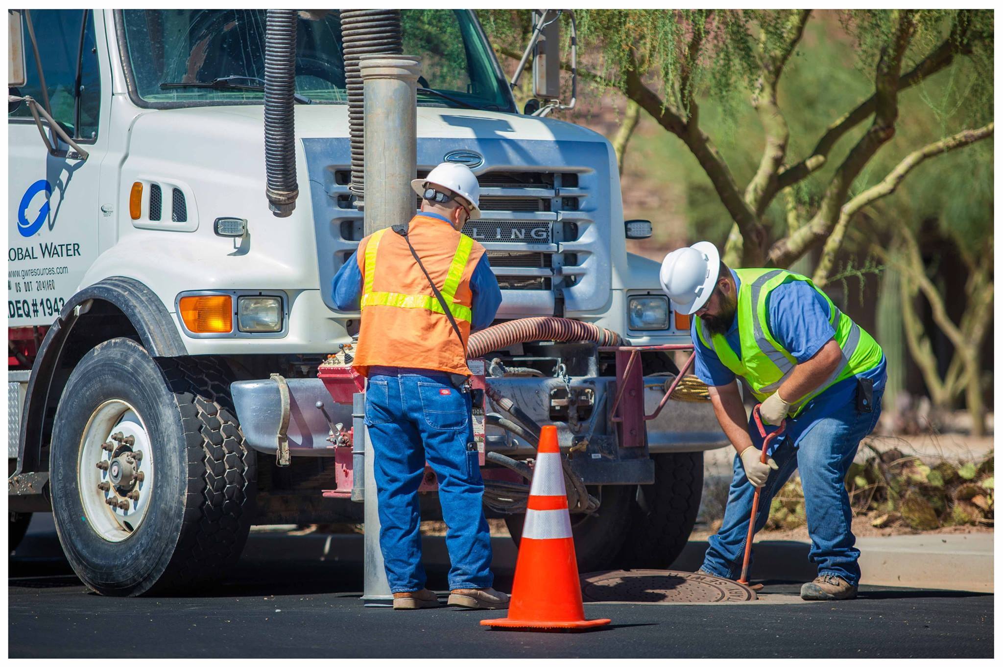
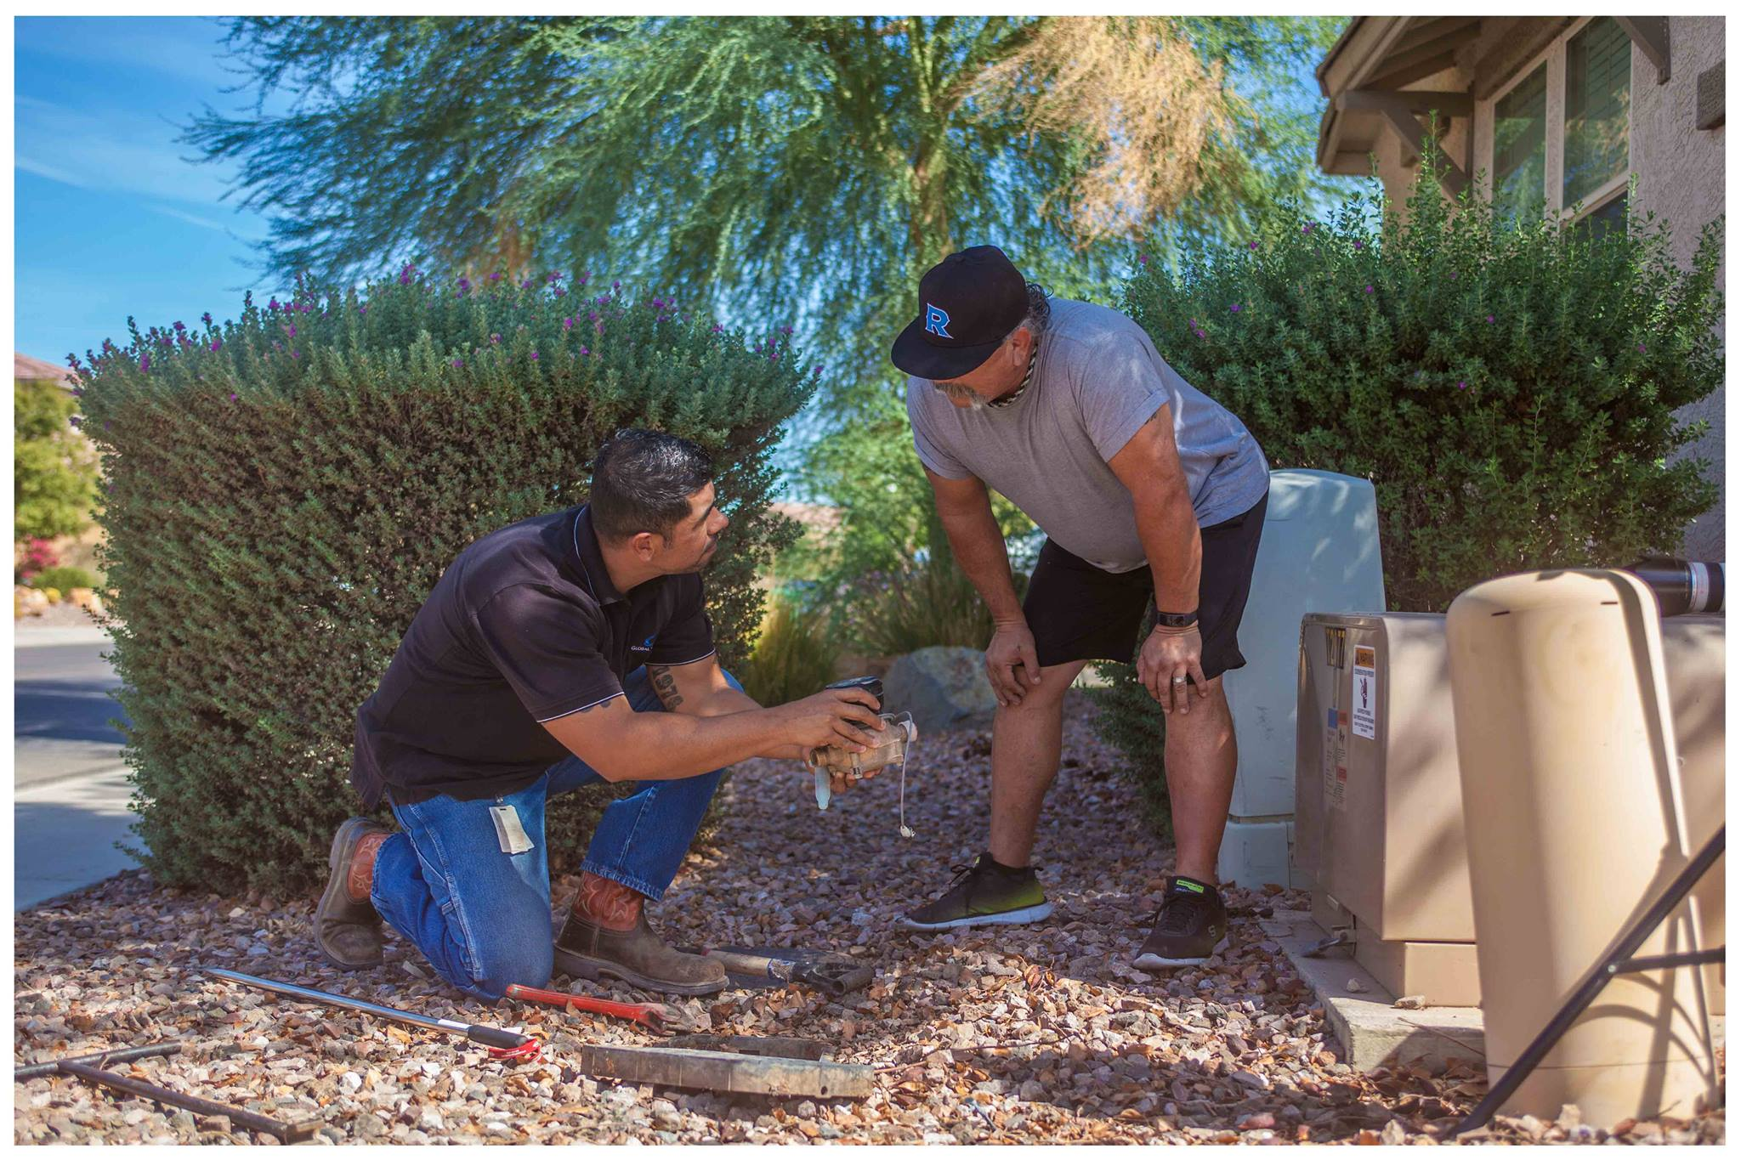
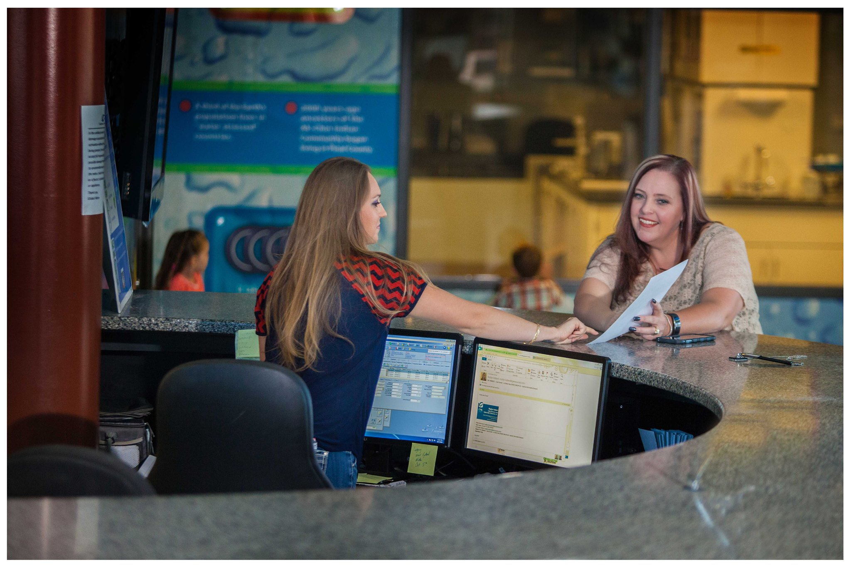
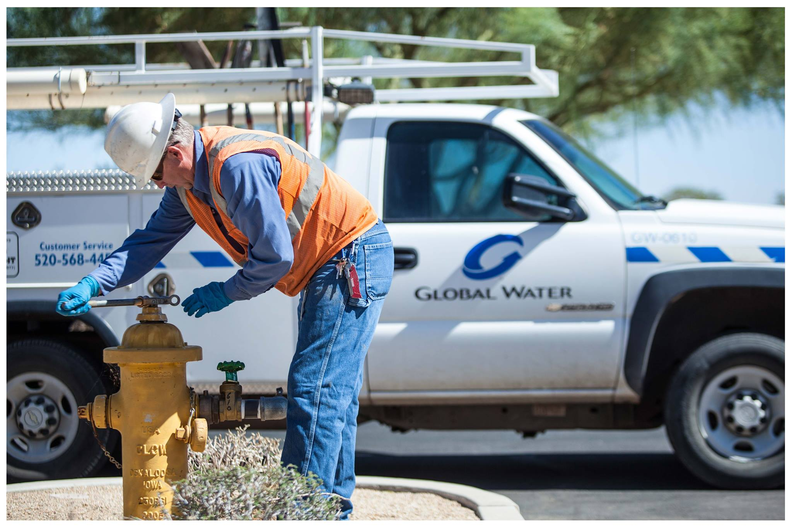
Thank You

