Slide 1
Global Water – Mirabell Water Company, Inc. Update
Jon Corwin, Vice President and General Manager
James Segrave, Operations Support Manager
Beth Huerta, Client Services Manager May 11, 2023

Slide 2
Agenda
Global Water
System Improvements
Customer Portal
Rate Case Update
Customer Assistance Program Review

Slide 3
About Global Water
Founded in 2003
Only Operate in Arizona
Employ Approximately 100 Arizonans – Engineers, Certified Operators, Compliance and Safety Professionals
Provide Water, Wastewater and Recycled Water Service to 59,800 Connections
Conservation Focus
Total Water Management
Saved over 10 billion gallons of water since 2004
Customer tools for conservation

Slide 4
Global Water – Mirabell Water Company, Inc.

Slide 5
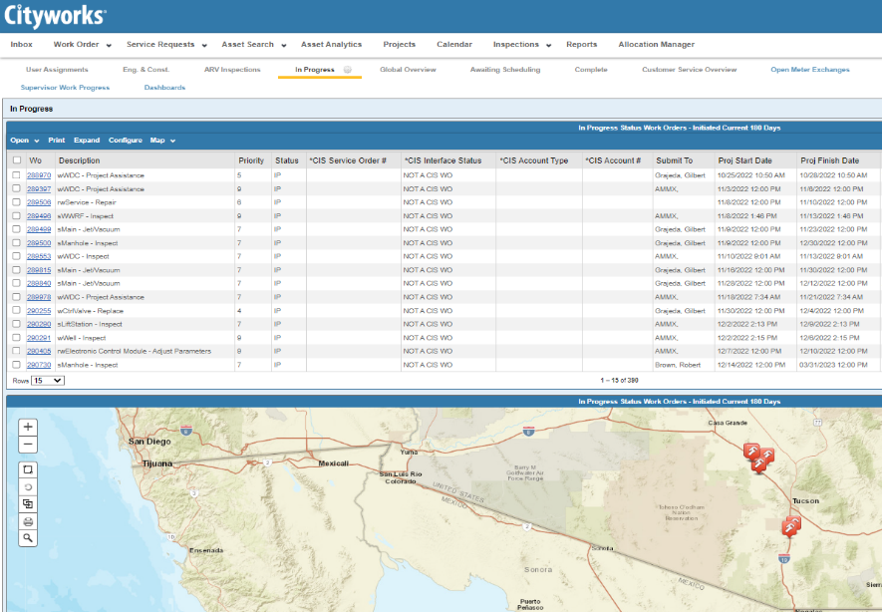
Integration Work Completed
Utility Focused Team – Water Resources, Compliance, Safety, Maintenance Expertise
Staffed Call Center and After-Hours Service (Nov 2021)
Asset Management / GIS Deployment (On-Going)
Improved asset maintenance tracking
Enhanced emergency response
Enhanced IT & OT Security (Jun 2022)

Slide 6
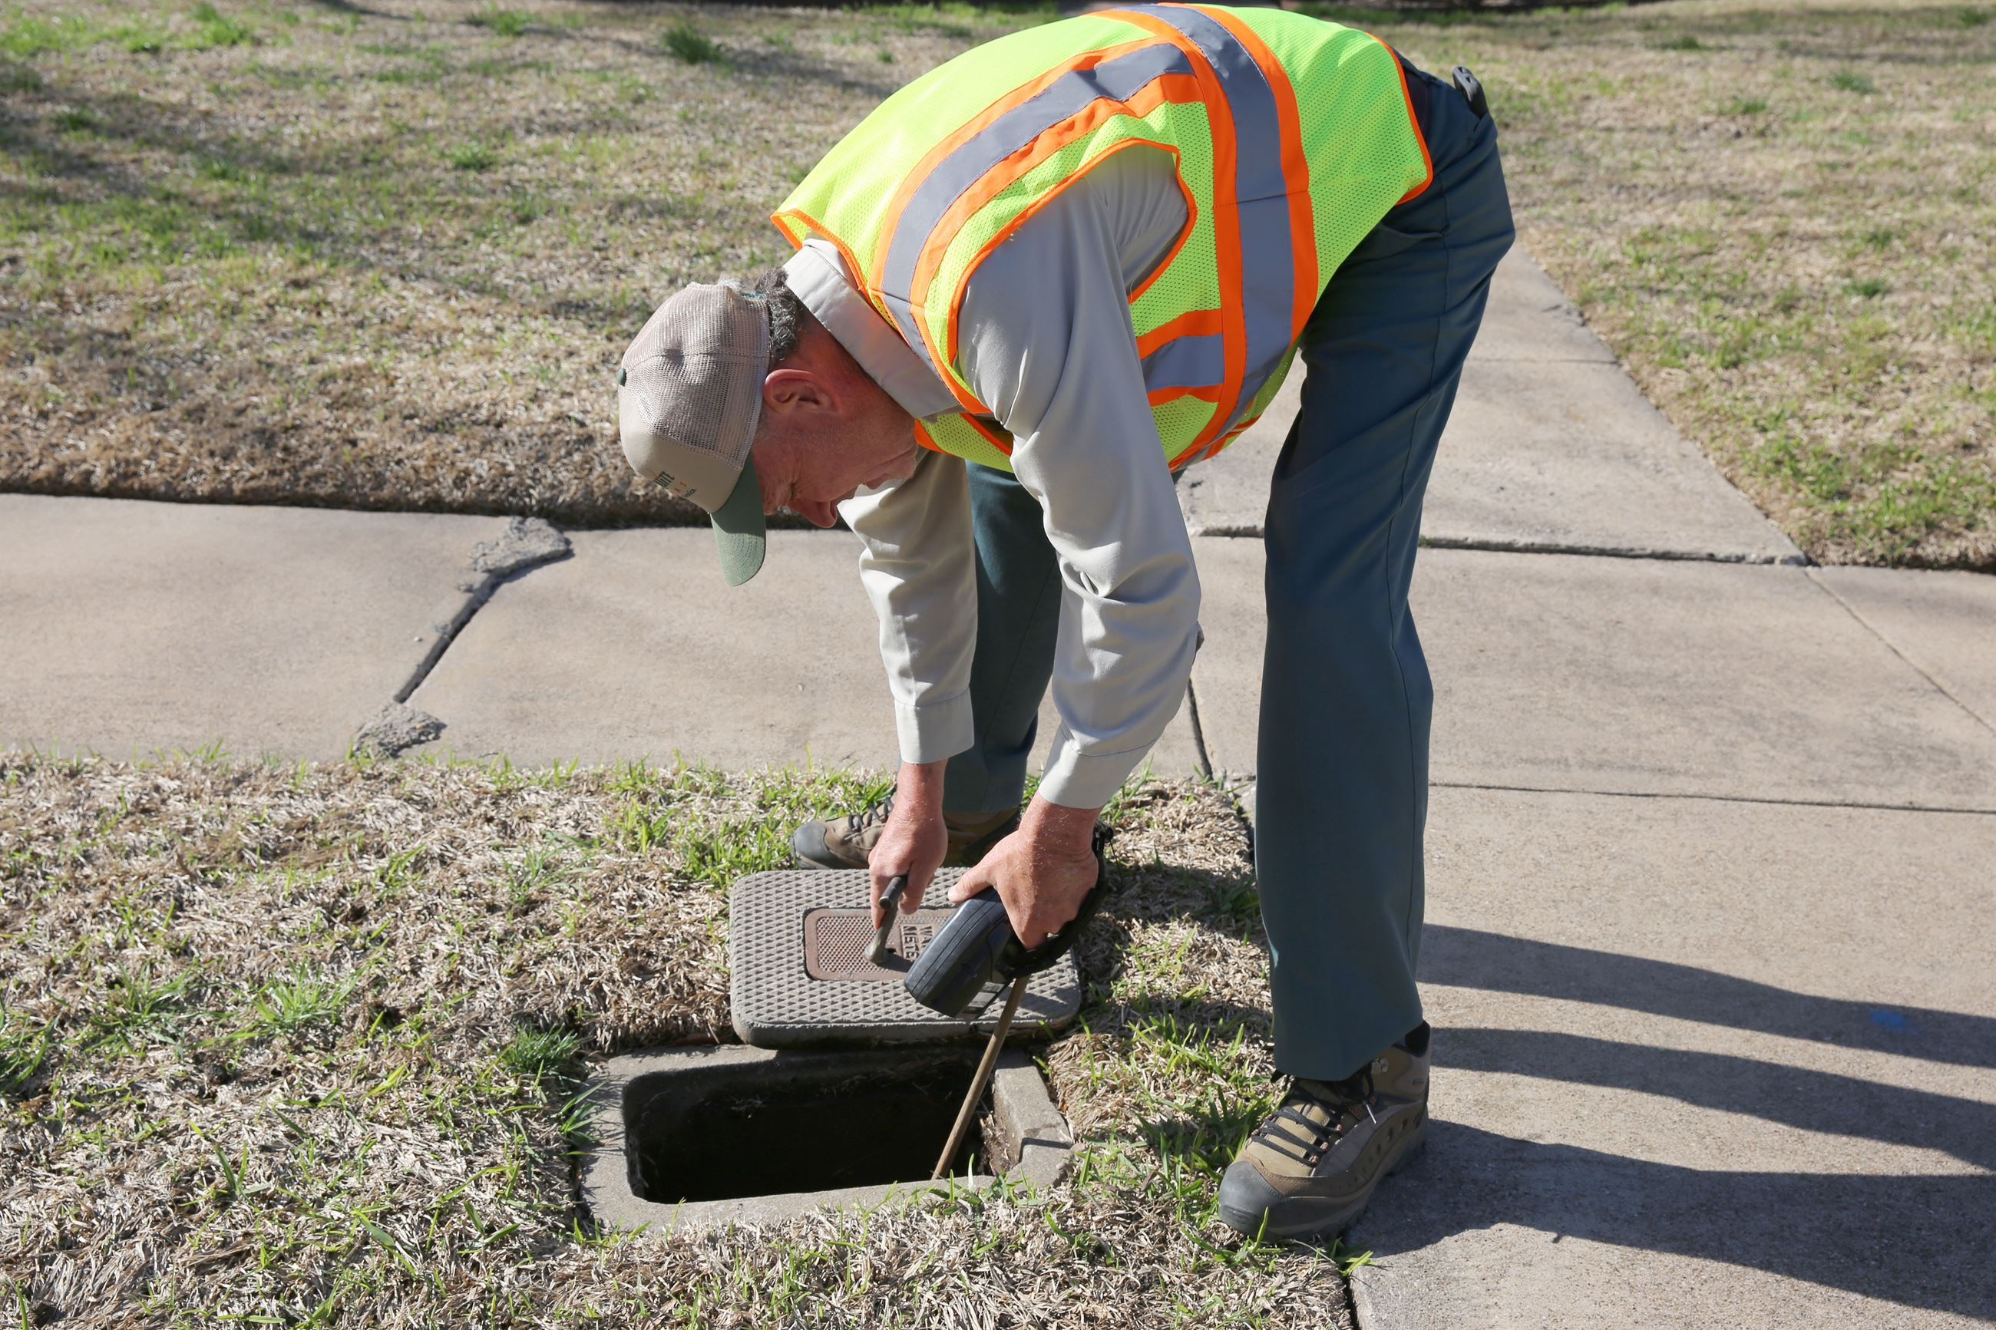
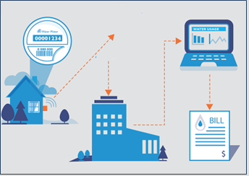
Meter Exchange Summary
Installed Neptune R900i E-CODER Meters
Drive-by meter reading technology
96 days of stored history for troubleshooting
Meter reading process will take approximately 0.5 manhours versus 4 manhours
Opportunity for human error significantly reduced
Manual Reads
To
Drive-by Reads

Slide 7
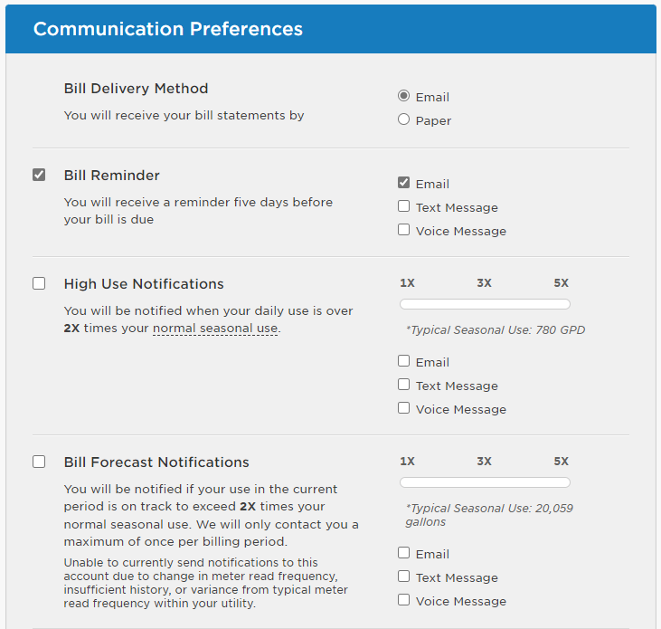
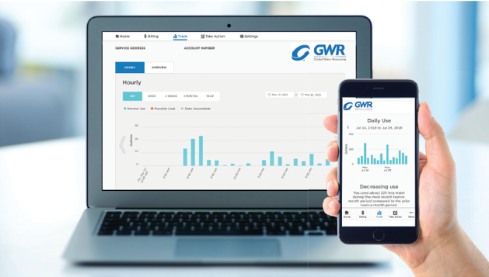
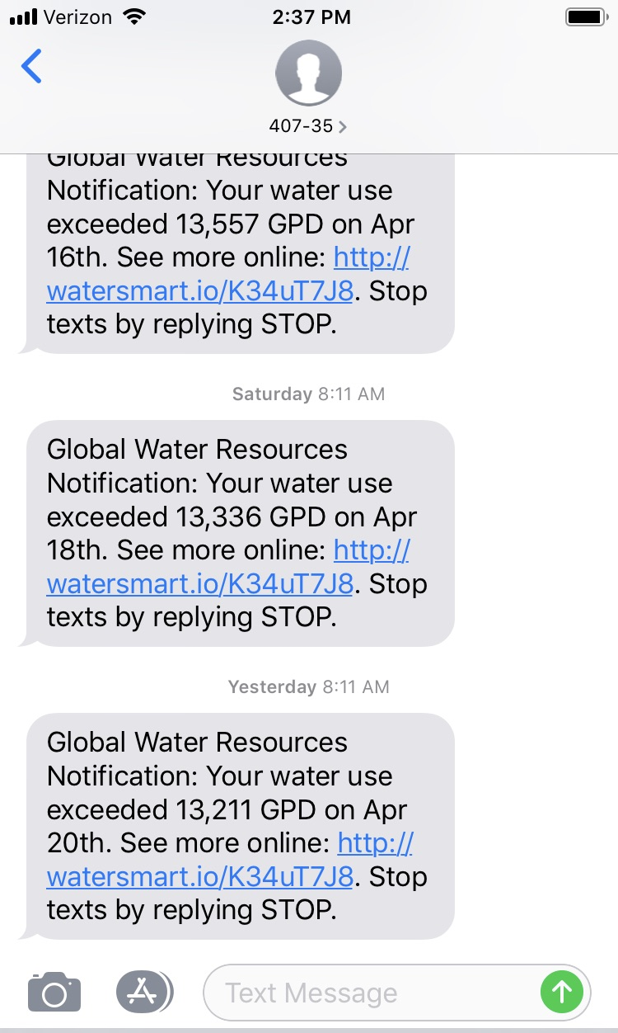
Customer Portal

Slide 8
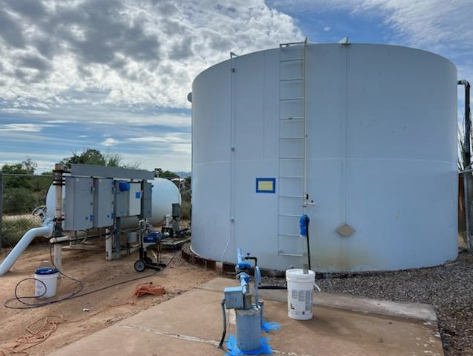
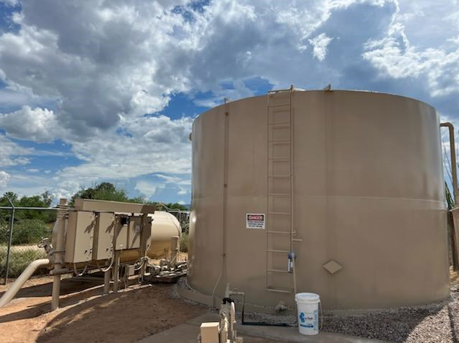
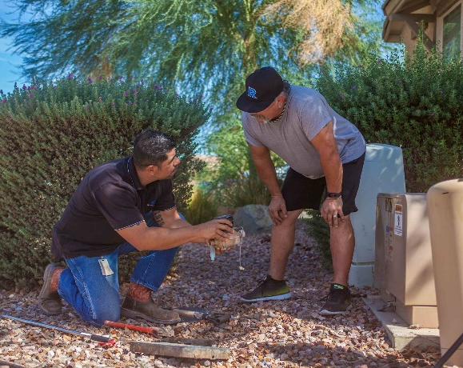
Completed Improvements
General Site Upgrade
Well starter controls were replaced
Painted and Maintained Storage Tank
Numerous Service Line Replacements Due to Leaks
Meter Replacement Project

Slide 9
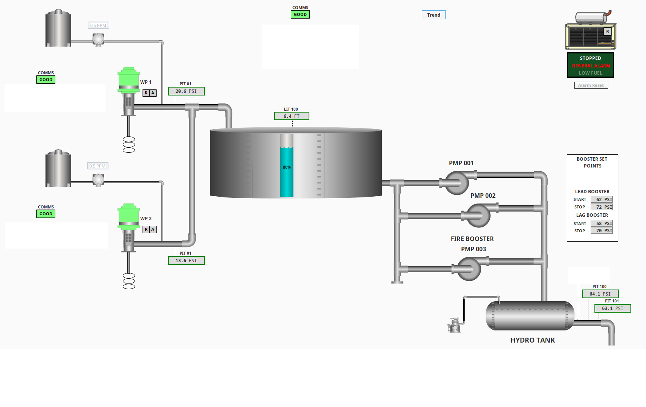
Future Improvements Planned
Deployment of Supervisory Controls and Data Acquisition (SCADA)
Provides enhanced remote monitoring and alarming capabilities
Construct Interconnect with Contiguous Public Water System
System currently has a single well. Interconnect creates system redundancy.
Automate Hydro-pneumatic Tank Operation

Slide 10
Rate Case
Rate Case Filing in Mid-2023
In-depth review by Arizona Corporation Commission
Reason for a Rate Case
Last rate case test year was 2010
Inflation - labor, materials, chemicals, fuel, power have all increased significantly
Recover costs of system improvements
Process/Timing
Rate case timeclock is 270 days meaning, once we file, rates will not be implemented for 270 days. No rate change until late 2023 or early 2024
Commit to Come Back and Provide Updates

Slide 11
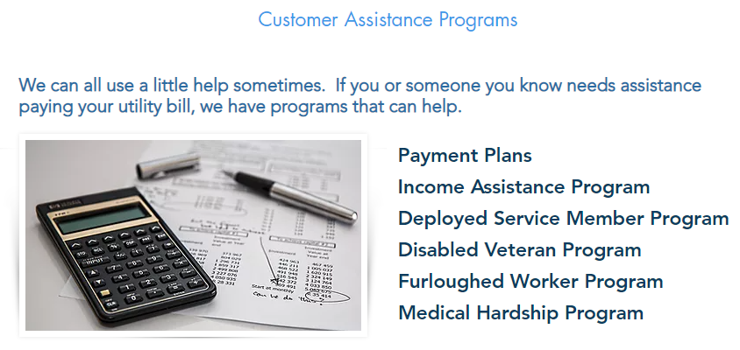
Customer Assistance Program
Summer 2022 – Implemented Customer Assistance Program
Up to $350 in annual assistance
Eligibility
Low Income
Deployed Service Members
Disabled Veterans
Furloughed Workers
Medical Hardship
GWR contributes $50,000 Annually

Slide 12
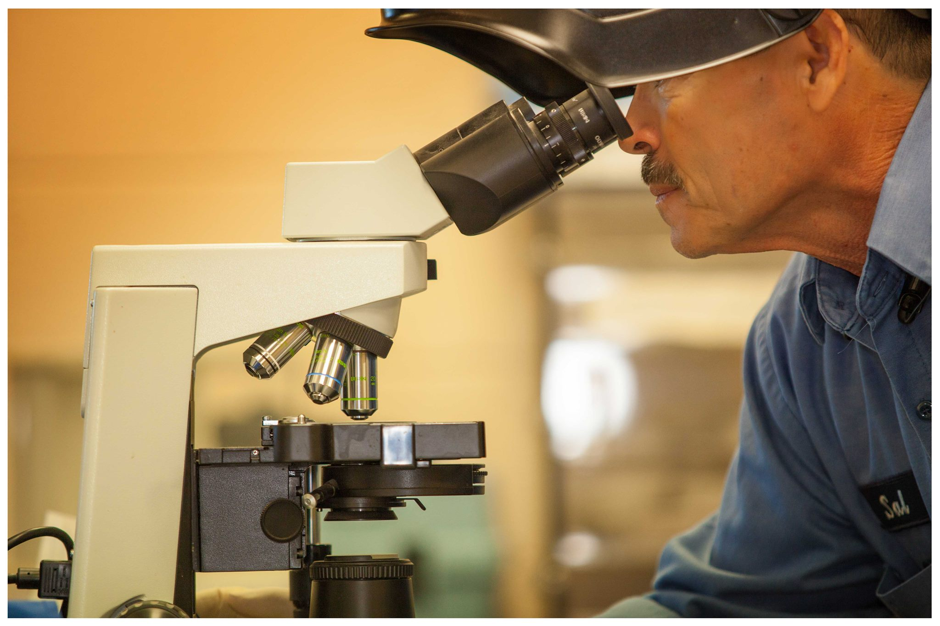
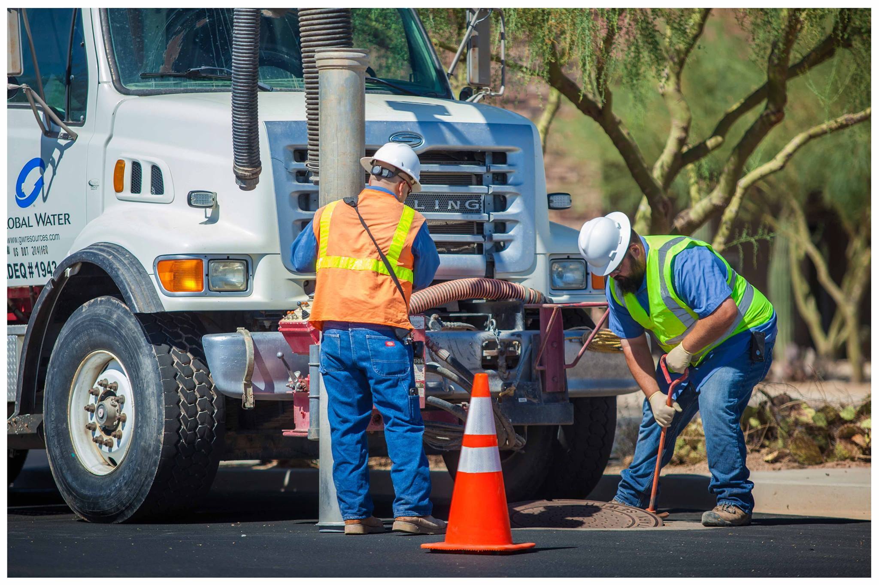
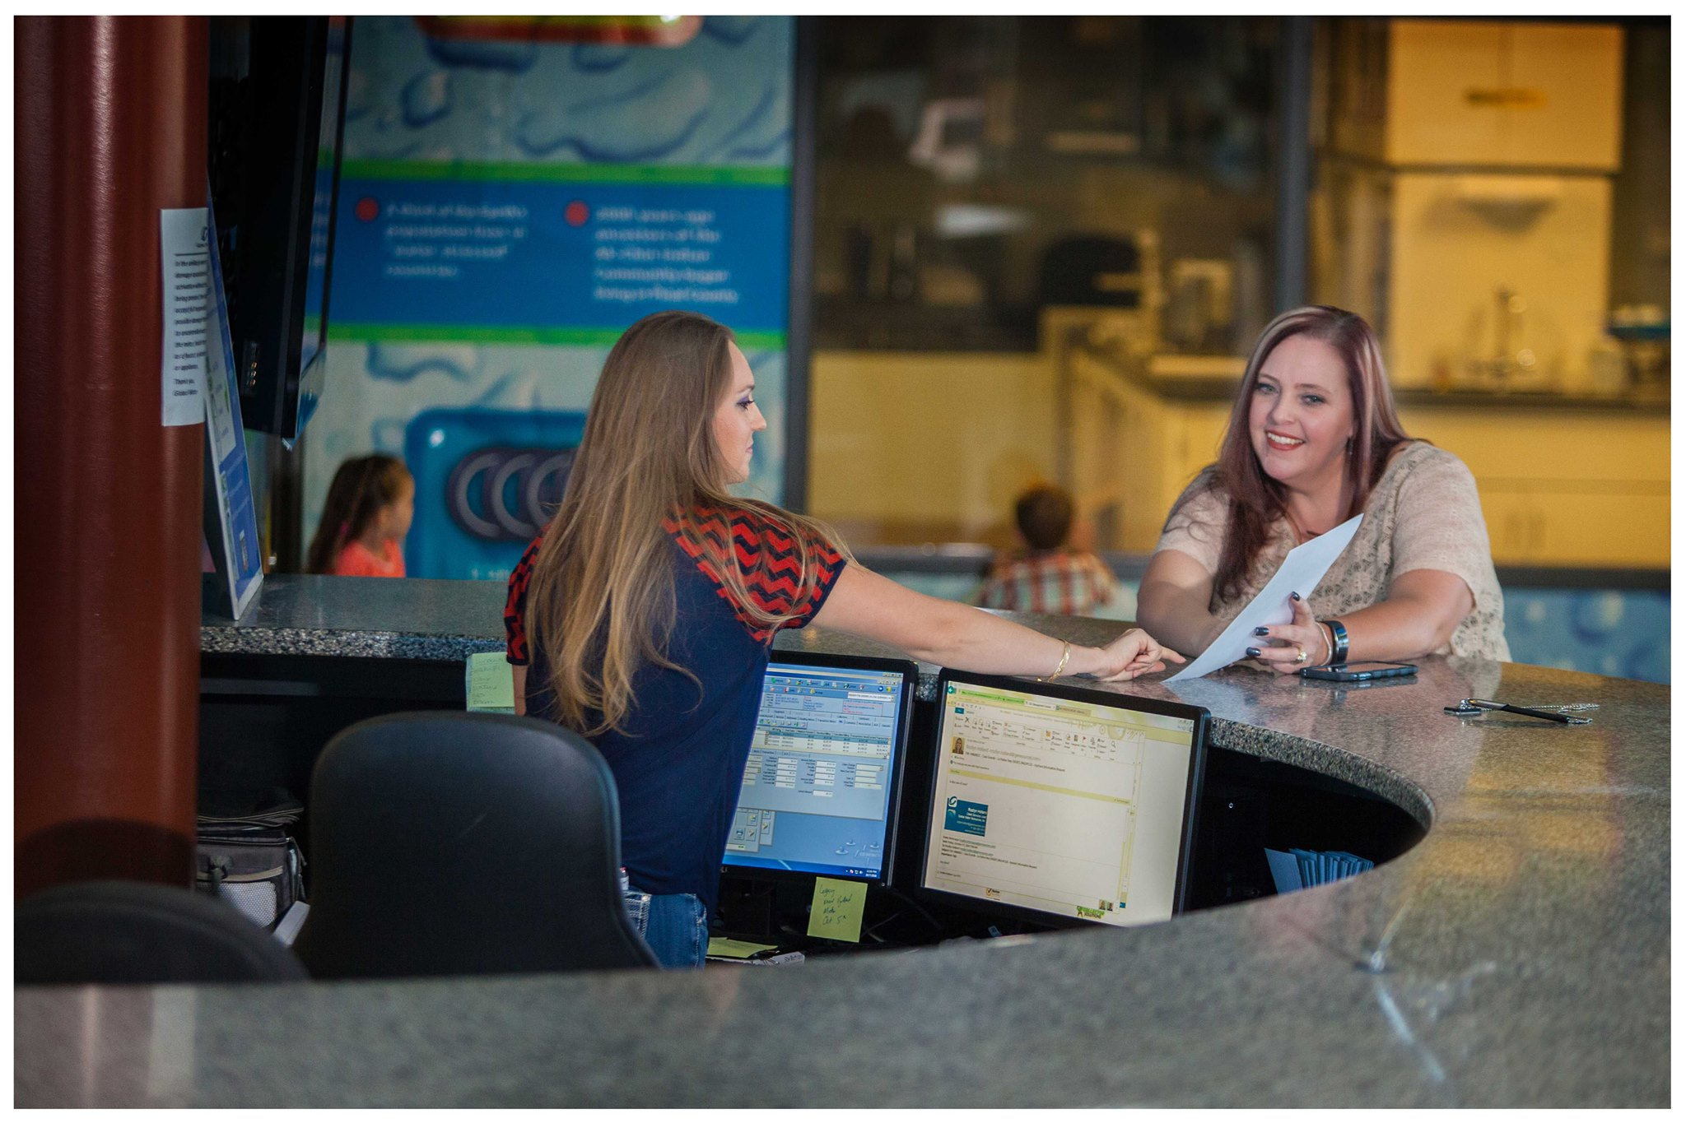
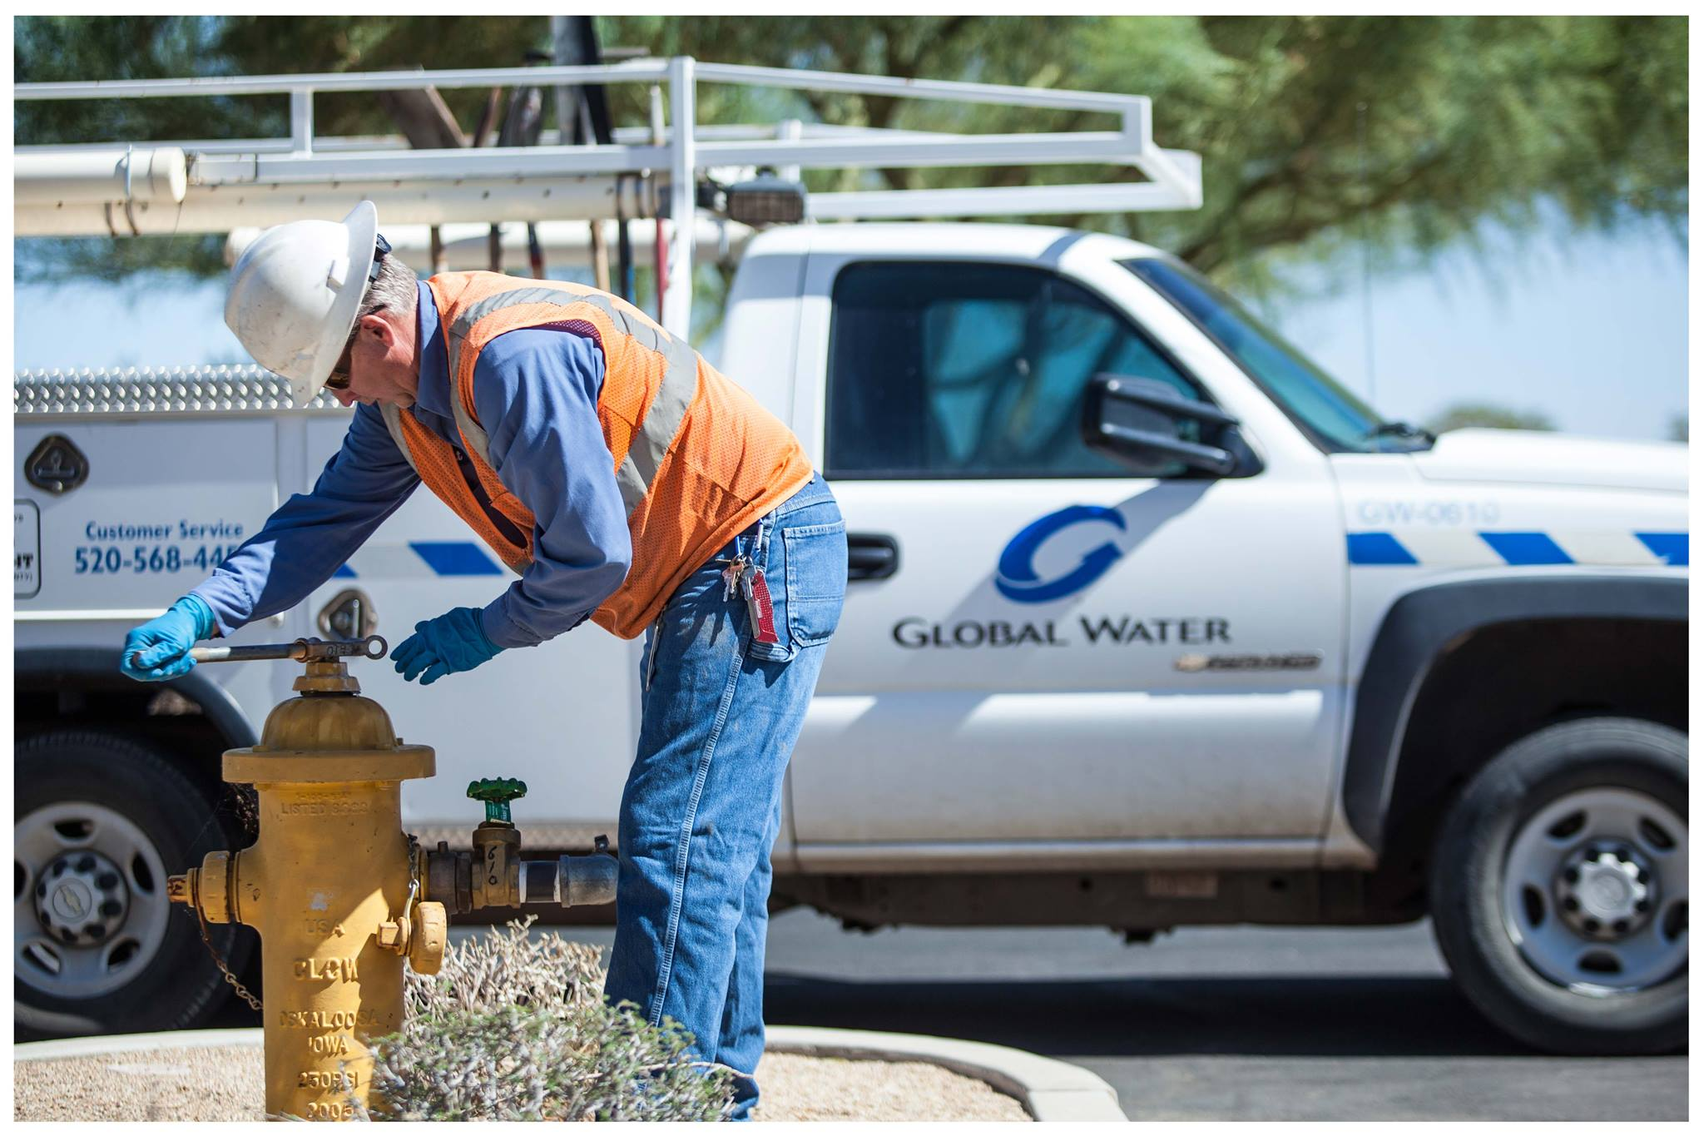
Thank You

